Slide 1
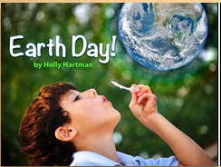
Lesson: Celebrations
Today I can: Listen to the two stories and write a short book about my favorite celebration.
Action: Listen to the stories by clicking on each book Choose your own favorite celebration Create a book about your celebration
Thinking about it: Read the story you wrote. How does it make you feel? What do you like about your work?
Notes:
https://docs.google.com/presentation/d/1aiBjmzFjpCosRQusJTTLuPxg7BQx9AEi3q2v2uCn2Po/edit#slide=id.g9693175ca2_0_76

