Slide 1
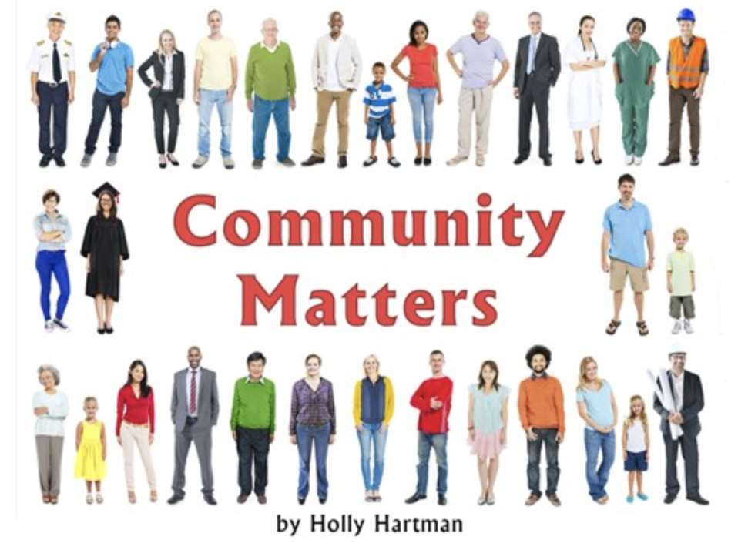
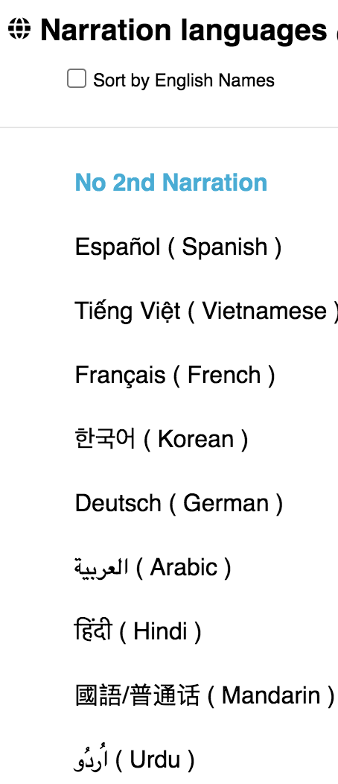
Lesson: Community Matters Click here for a Google Doc version of this activity (for translation purposes)
Success Criteria: Today I can… ✔️identify the people and places in my community ✔️describe how they help to serve the community ✔️draw or write how I can help in my community
Action: Listen to the story “Community Matters”. Click on the picture of the book. Click the tab to listen to the book in English or your preferred language. Choose your language. Draw a picture of your community including important people and places. Tell someone how the people and places serve the community you live in. Write a sentence or two about how you can help in my community. Use the sentence starter “ I can help in my community by…..”
Click on the audio icon to hear these instructions read to you .
Learning Goals:
I am learning to…
-identify and describe the people and places in my community, and how they help to serve the community.
Notes:
Link to text google doc: https://docs.google.com/document/d/1f-sjmYxf_bQhxtp3j-6Ac0T3BF39c35iBhY2blBztVo/edit

