Slide 1
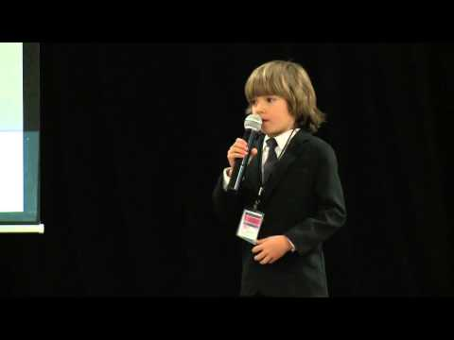
Lesson: Kids Need Recess
Today I can: -understand the purpose and message of a speech -understand why words are repeated in a speech -understand how ideas and evidence support the purpose and message of a speech
Action: Watch and listen to the video, called Kids Need Recess. Think about words repeated in the speech. What is the topic? What is the purpose and message of the speech? How did Simon Link support his ideas? Do you agree or disagree that kids need recess? Why or why not?
Thinking about it: What is something that is important to you? Why is it important? Find a family member or friend and explain what one thing is that is important to you and why it is important to you. When you are finished ask them whether the ideas you shared were clear.
Notes:
Instructions: https://docs.google.com/document/d/130Mg2Y5JBgVGhtVmSCUBPe1lW--JK1vWEd319Ea9FSM/edit#

