Slide 1
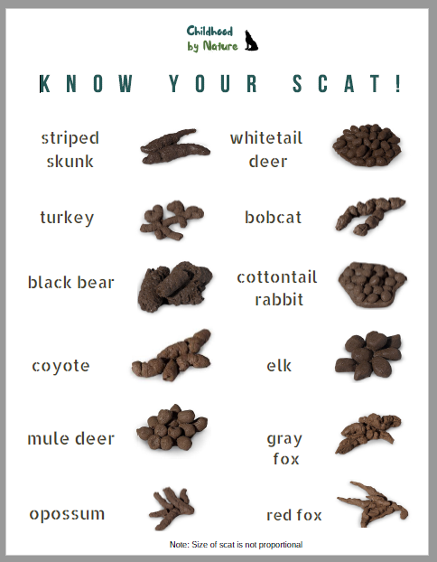
Click on the image to get your own copy of the Scat ID field sheet from Childhood by Nature:
Lesson: Scat! Scat? Eww! Gross!
Today I can: Identify the animals with whom I share space Draw a picture and write about one of these animals
Action: Have you ever heard anyone tell someone to go away and use the term, “Scat!” ? Do you know what “Scat” means? Can you now take a guess? Get yourself a copy of the field sheet linked to the image beside. Go for a walk - in and around your neighbourhood. Look for scat. See if you can identify to which animal it belongs. Check off the animals you were able to identify. Return home and use the internet to search for the animals. Pick and choose one animal to read, draw and write about one or more interesting facts.
Thinking about it: Share your animal picture and fact(s) with your family and/or class. What did you learn from this activity?
Notes:
https://docs.google.com/document/d/1lD5KVlGOvW5YjRu4Y0kanUnMSKgppiO2EudZVU1NQzg/edit

