Slide 1
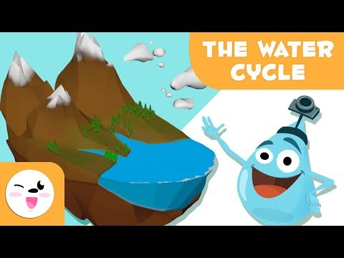
Lesson: The Water Cycle
Today I can: Identify the different parts of the Water Cycle Explain how the Water Cycle Works
Action: Watch the video about the Water Cycle As you listen to the video, starting writing down the words that are in the Water Cycle on a piece of paper or in a Google Doc
Thinking about it: What are the different stages in the Water Cycle? How does the Water Cycle impact the way we live (give examples)? Can you draw your own picture of the Water Cycle?
Notes:
Google Doc Text Version: https://docs.google.com/document/d/197WIcPtwjI87tMPetfn47TCHvNcrfBYcWFg5n-AS_lo/edit

