Slide 1
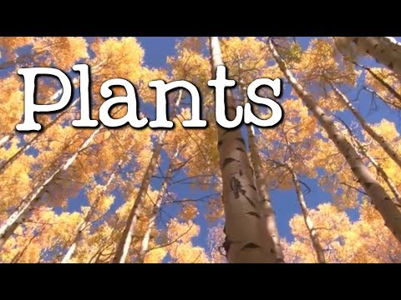
Lesson: What’s a Plant?
Today I can: Explain what a plant is Explain what plants need to grow Give examples of some plants
Action: Watch the video on plants! Take notes as you’re watching the video as there are a lot of facts being shared.
Thinking about it: What makes a plant a plant? What do plants need to grow? Where do you see plants in real life?
Notes:
https://docs.google.com/document/d/1I7VTGrzg_b43GV_0meeH-MXy_-EkcX6600a6KHIwT74/edit?usp=sharing

