Slide 1
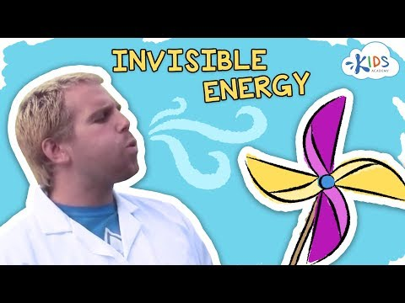
Lesson: Wind Energy
Today I can: Identify different types of energy Explain how wind energy works
Action: Watch the video about wind energy Record some of your ideas on a piece of paper or in a Google Doc
Thinking about it: What is energy? What are the different types of energy? Which objects did the wind energy push the furthest?
Notes:
https://docs.google.com/document/d/1Nfl44YbLkdxulS8DNmXSEOT6w2Wgtunl3_qG9owpv84/edit?usp=sharing

